Slide 1
Incorporating Feedback

Slide 2
Today
Causal Inference: Synthetic Controls
Incorporating Data Analysis Feedback

Slide 3
Synthetic Controls

Slide 4
What are synthetic controls?
Optimally weight non-treated group to form a `control’ for the treatment group.
We call this control a `synthetic unit.’

Slide 5
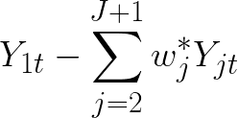
The estimator
We calculate the treatment effect as (treatment group j=1):
But how to determine weights?

Slide 6
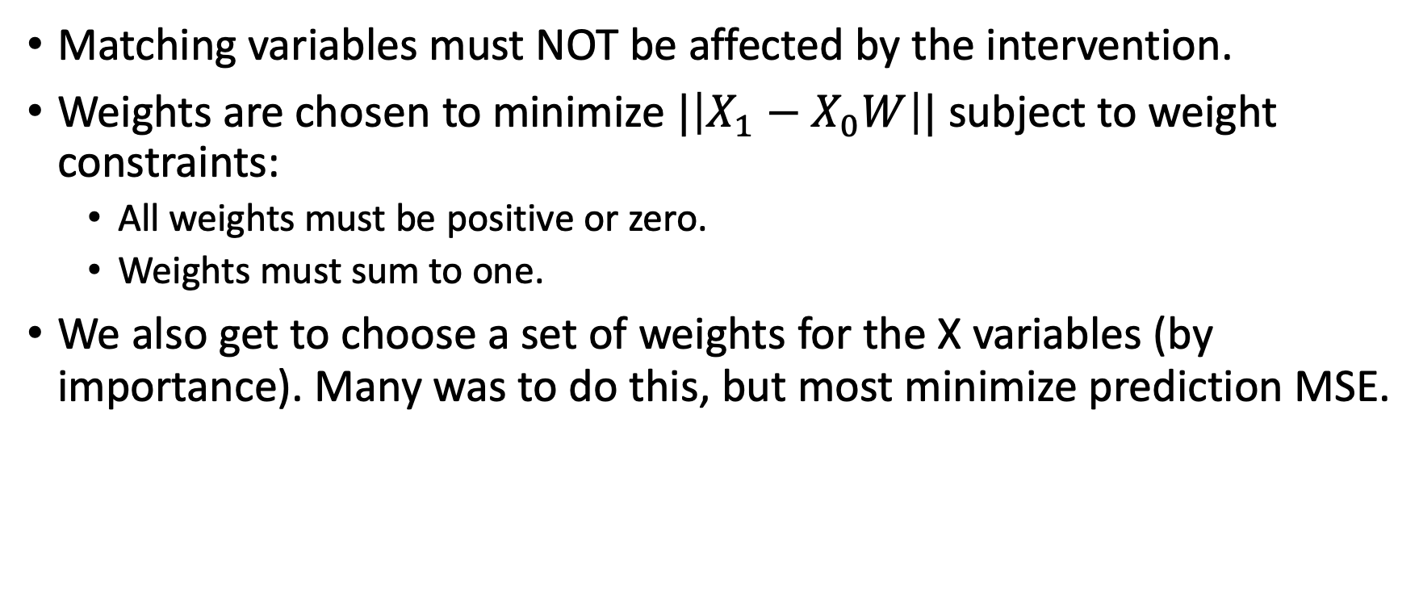
Choosing weights

Slide 7
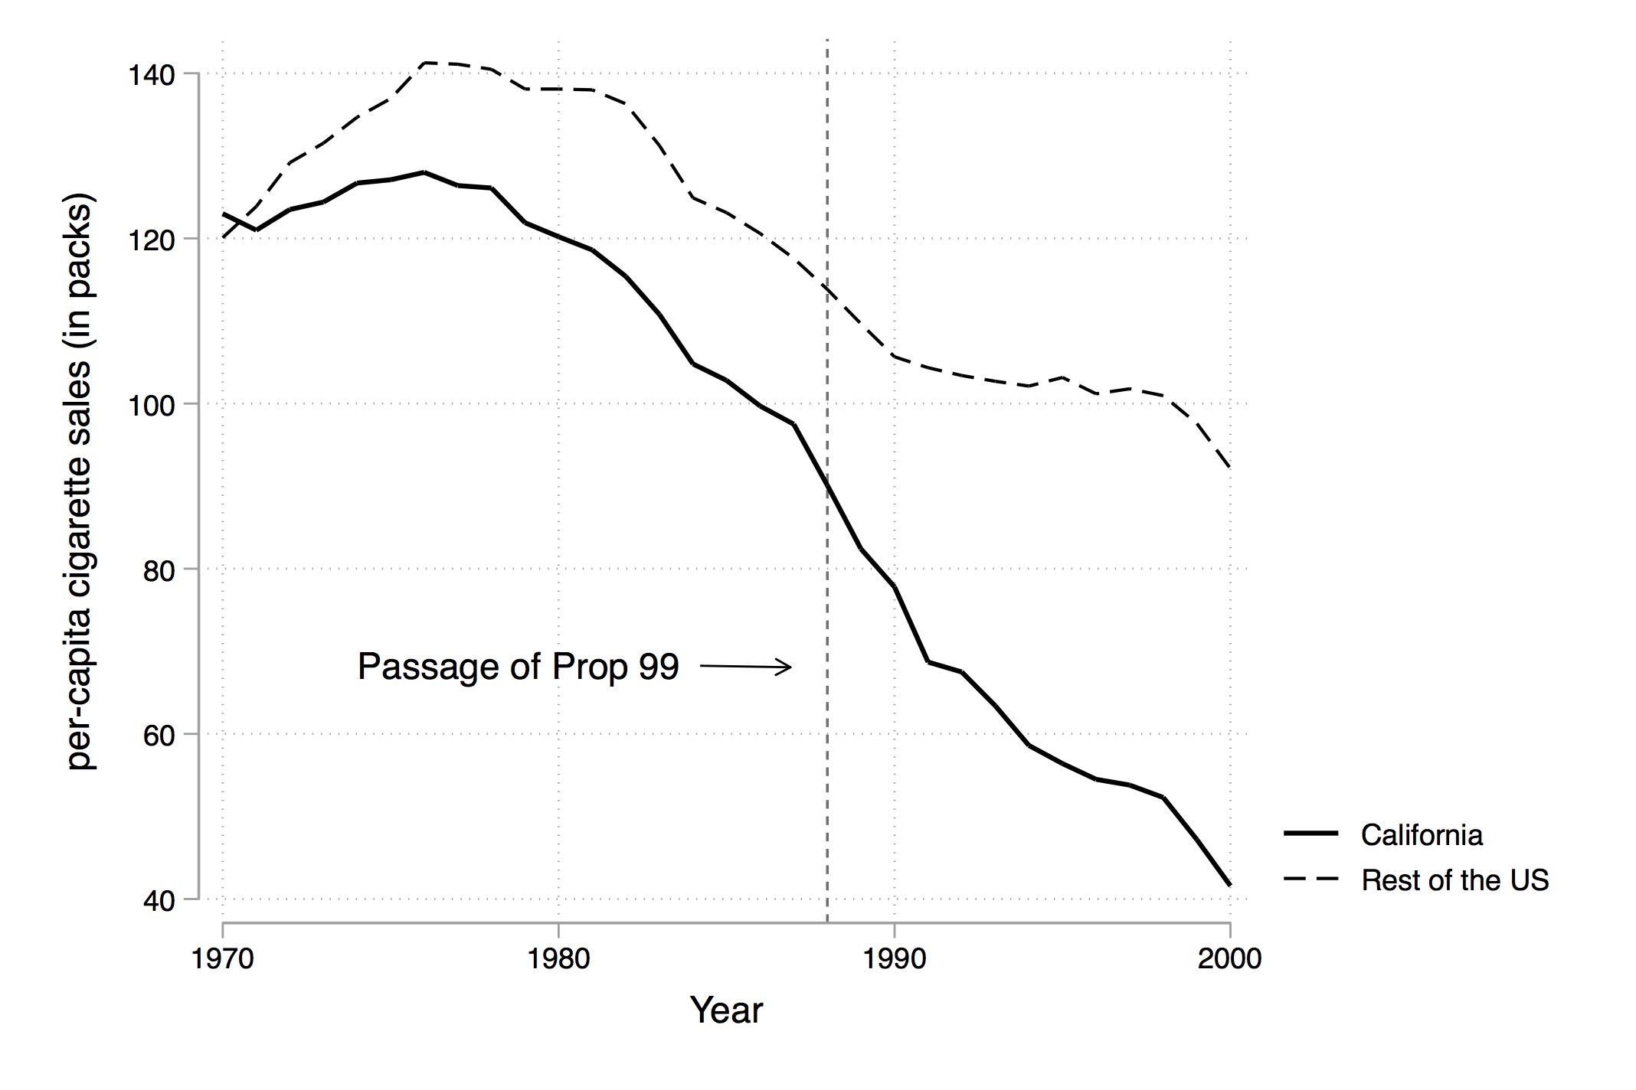
An Example
California passed Prop 99 in 1988. Increased cigarette taxes, anti-smoking media campaigns, and anti-tobacco ads/ projects.
Can we estimate the causal effet of the program?

Slide 8
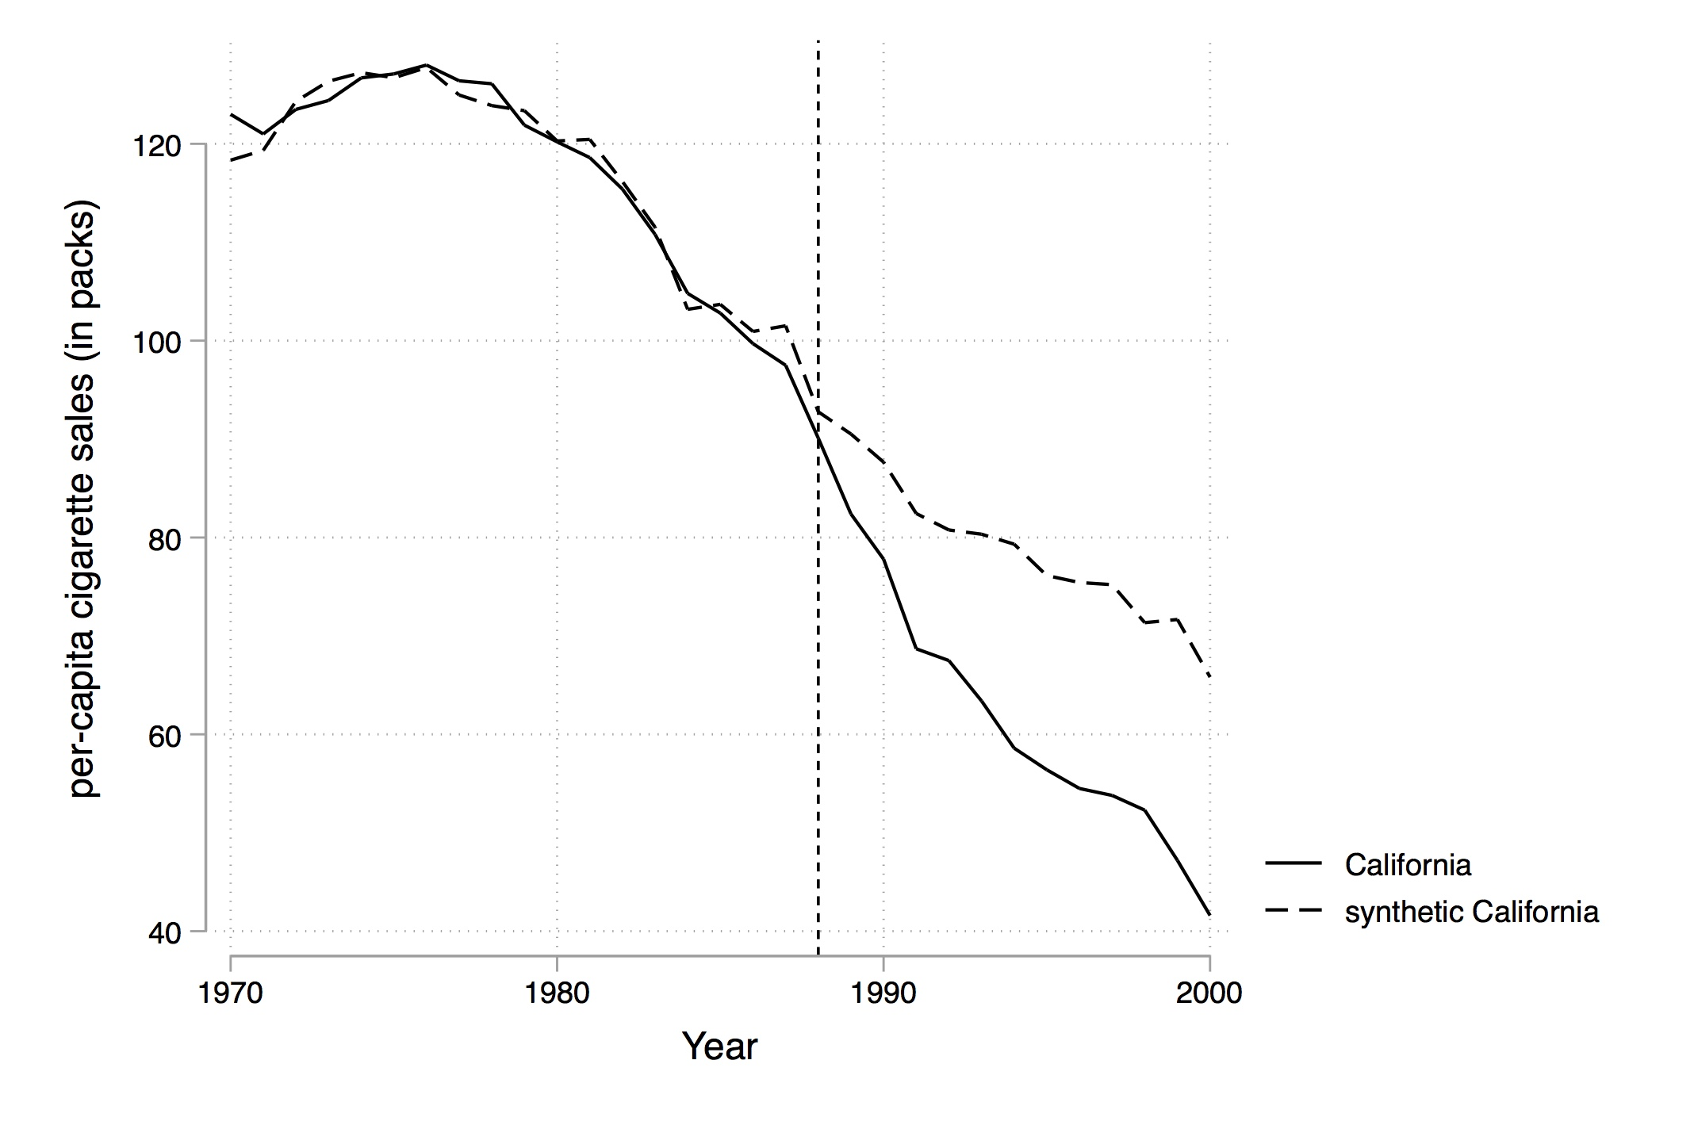
Demonstrating good weights
After optimal weighting, the pre-treatment time path for CA looks almost identical to the rest of the country! But then they diverge.

Slide 9
Balance Tables
We can also check whether the synthetic control matches the actual control states with a balance table.
Variables | Real California | Synthetic Calif. | Avg. of 38 Control States
Ln(GDP per capita) | 10.08 | 9.86 | 9.86
Percent aged 15–24 | 17.40 | 17.40 | 17.29
Retail price | 89.42 | 89.41 | 87.27
Beer consumption per capita | 24.28 | 24.20 | 23.75
Cigarette sales per capita 1988 | 90.10 | 91.62 | 114.20
Cigarette sales per capita 1980 | 120.20 | 120.43 | 136.58
Cigarette sales per capita 1975 | 127.10 | 126.99 | 132.81

Slide 10
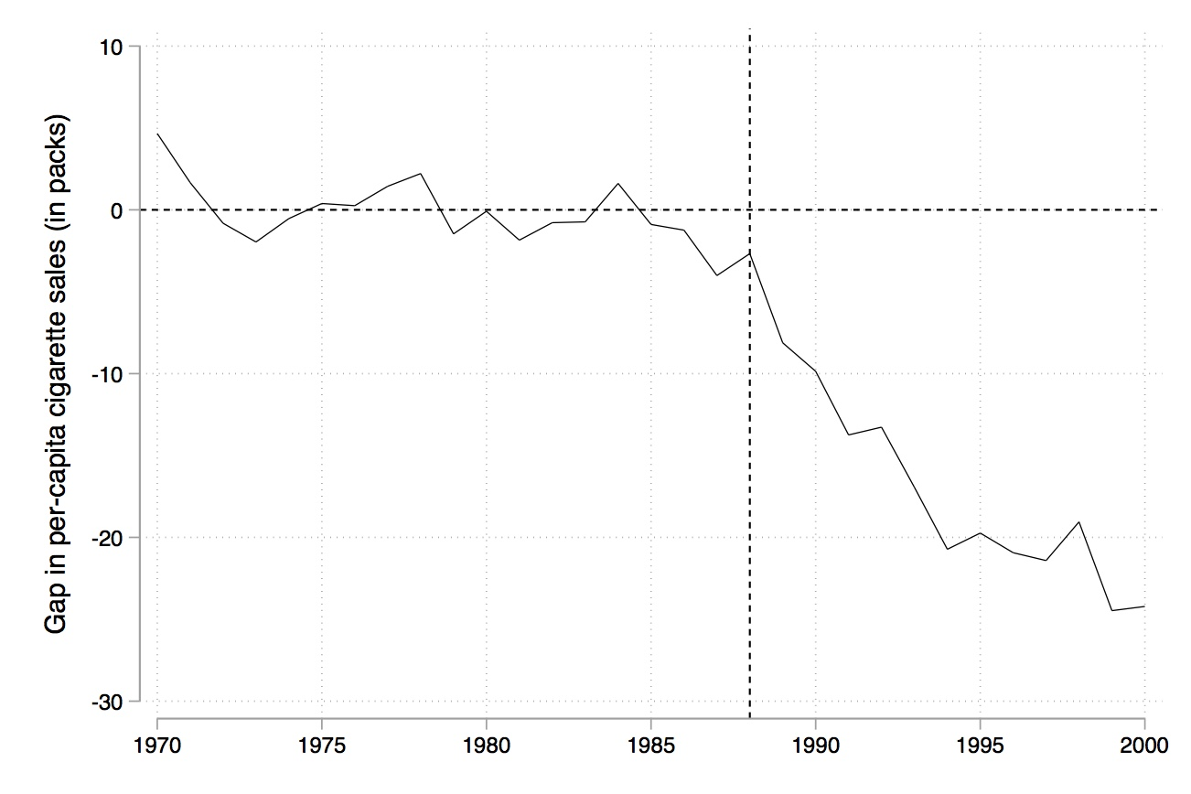
Key picture #1
Depicts just the difference between treatment and (synthetic) control.

Slide 11
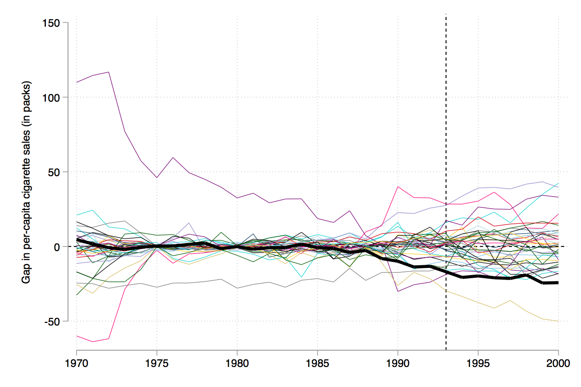
Key Picture #2
Distribution of placebo treatment effects.
From the graph, you can see California is an outlier – this is also more or less how p-values are calculated.

Slide 12
Proposal Feedback

Slide 13
Peer Feedback
If you haven’t yet, please take this time to provide feedback to your two assigned classmates on canvas.
If you have already done this, you are welcome to move on to today’s canvas survey and begin incorporating feedback from your classmates and Prof. Hobbs.

Slide 14
Incorporating Feedback

Slide 15
Incorporating Feedback
Based on the feedback you've received so far and the progress you've made, compile a list of the tasks you'd like to complete as you finish up your data analysis. Put them in two categories: "necessary" and "bonus.”
Identify any areas where you're stuck and could use help.
Describe your plan for completing your analysis.

